Slide 1
MND 500
Dr. Siddhartha Agarwal

Slide 2
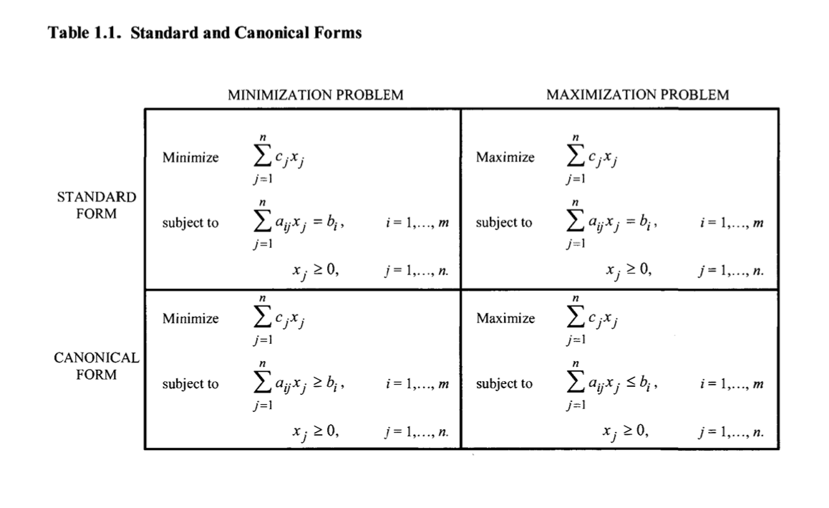

Slide 3
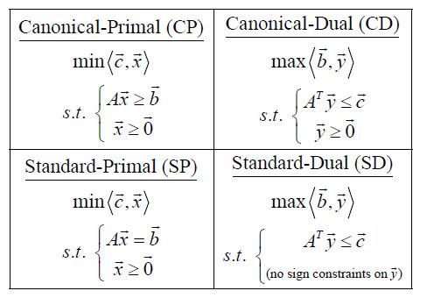
Canonical is converted to Standard by adding the slack or surplus variables

Slide 4
Introduction to Duality
For every linear programming problem there is a corresponding linear programming problem called the dual.
If the original problem is a maximization problem then the dual problem is minimization problem and if the original problem is a minimization problem then the dual problem is maximization problem.
In either case the final table of the dual problem will contain both the solution to the dual problem and the solution to the original problem.
The solution of the dual problem is readily obtained from the original problem solution if the simplex method is used.
The formulation of the dual problem also sometimes referred as the concept of duality is helpful for the understanding of the linear programming. The variable of the dual problem is known as the dual variables or shadow price of the various resources.

Slide 5
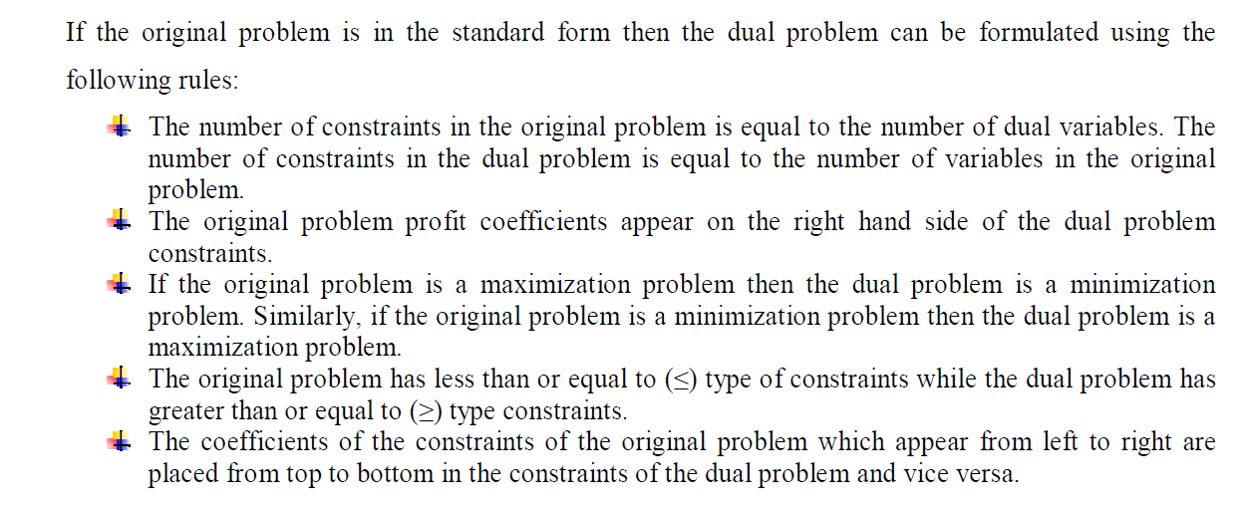
Dual Problem Formulation

Slide 6
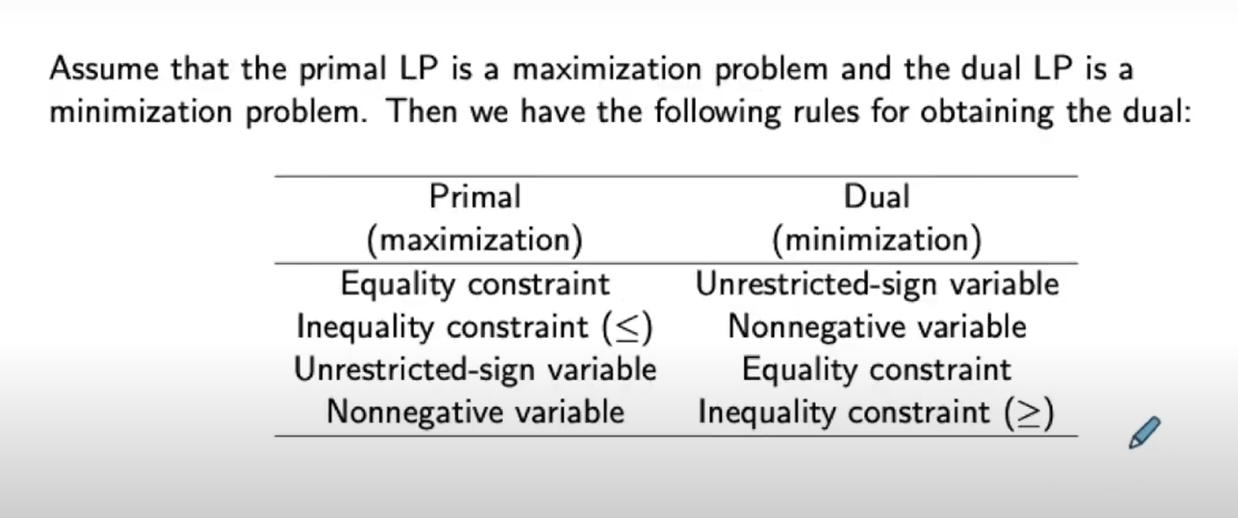
Rules for decision variables in Dual

Slide 7
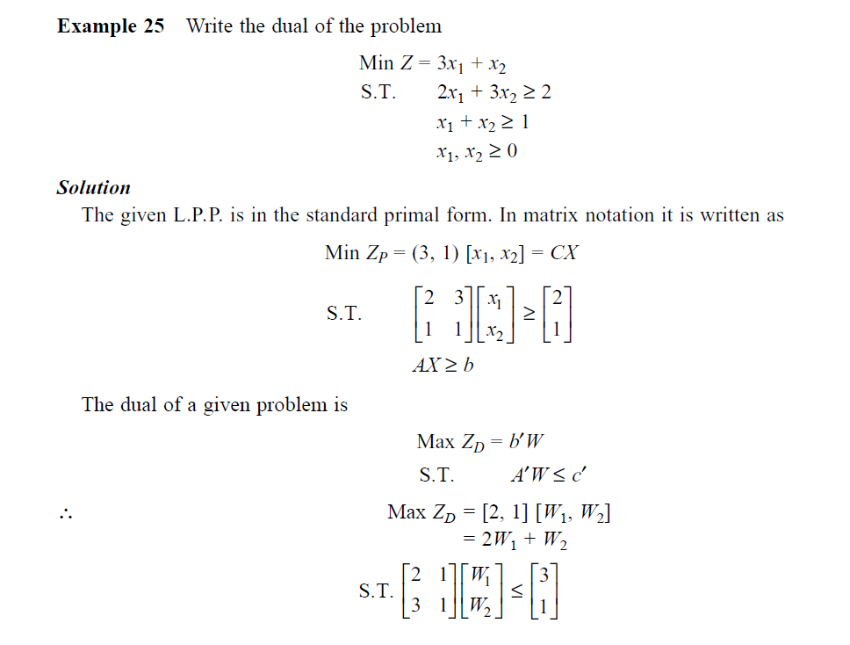

Slide 8
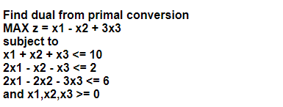

Slide 9
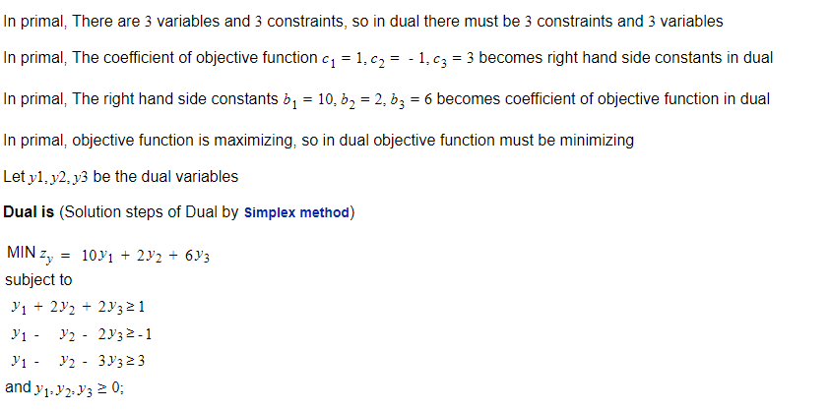

Slide 10
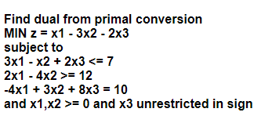

Slide 11
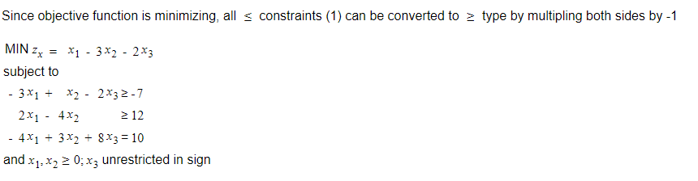

Slide 12
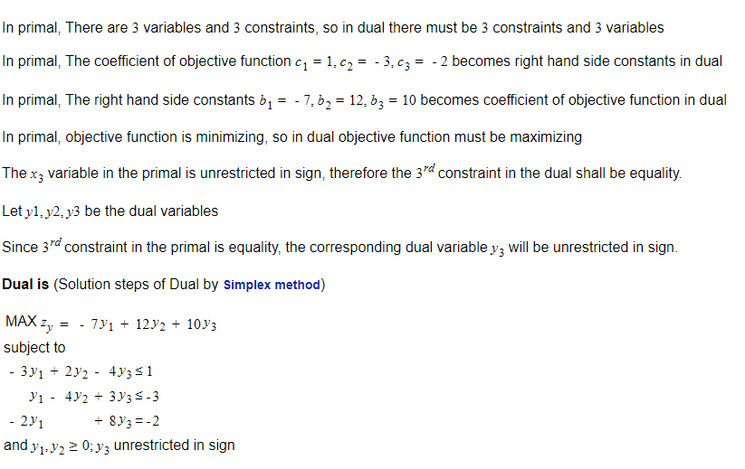

Slide 13
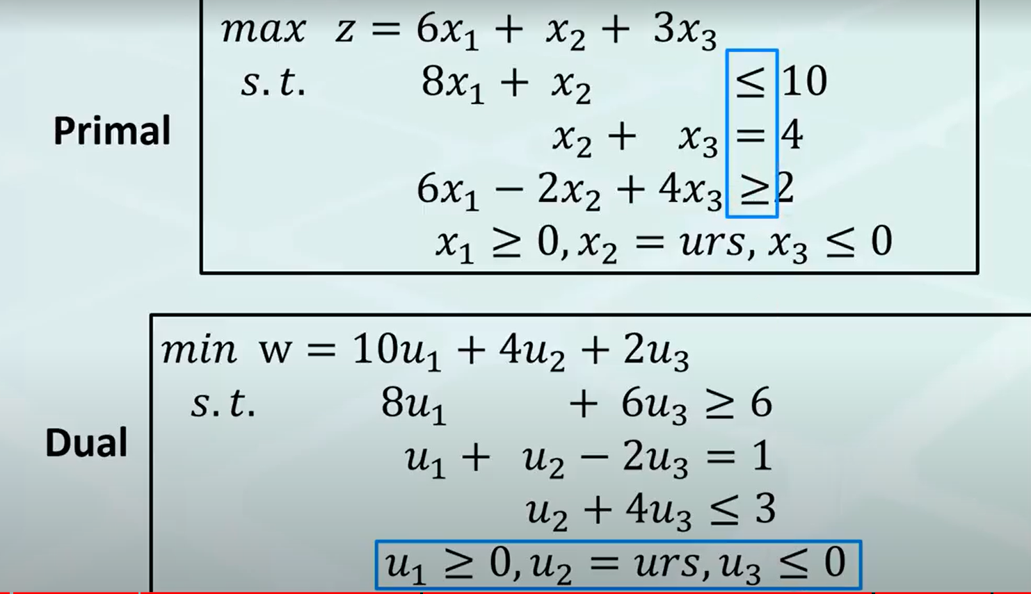
Non-Standard Form Dual

Slide 14
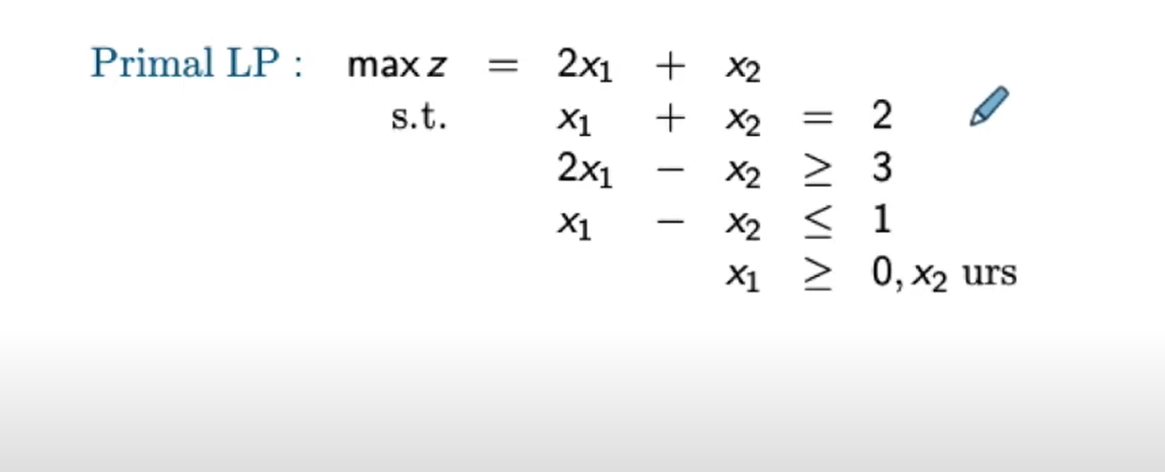

Slide 15
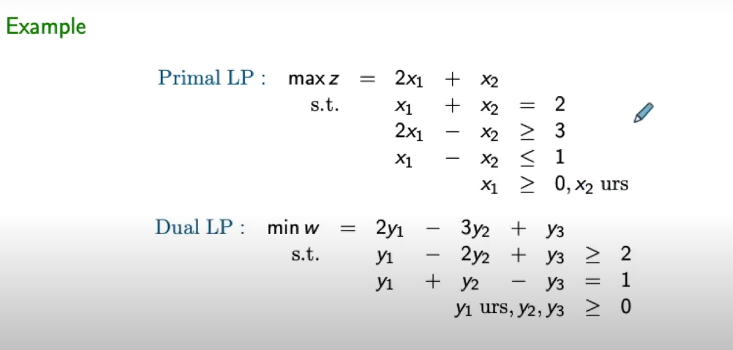

Slide 16
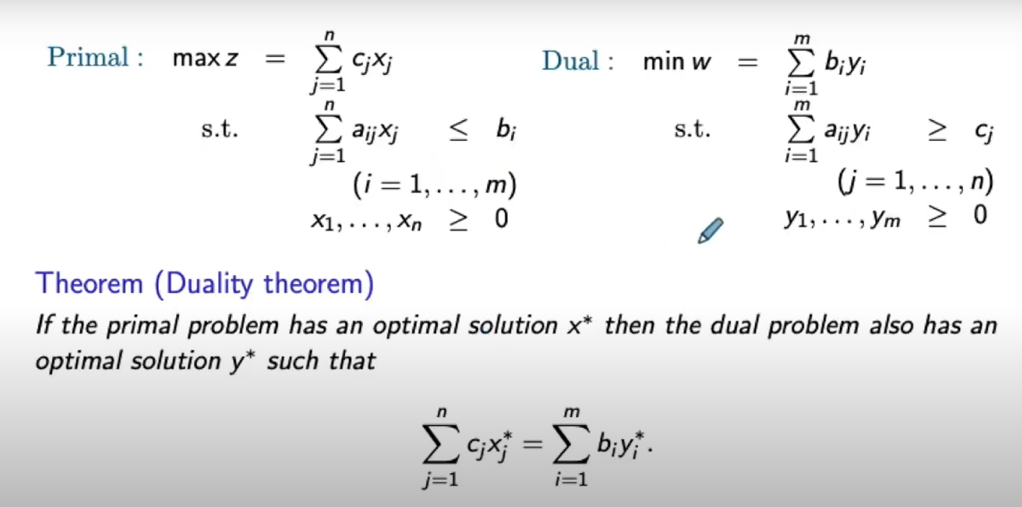
Duality Theorem

Slide 17
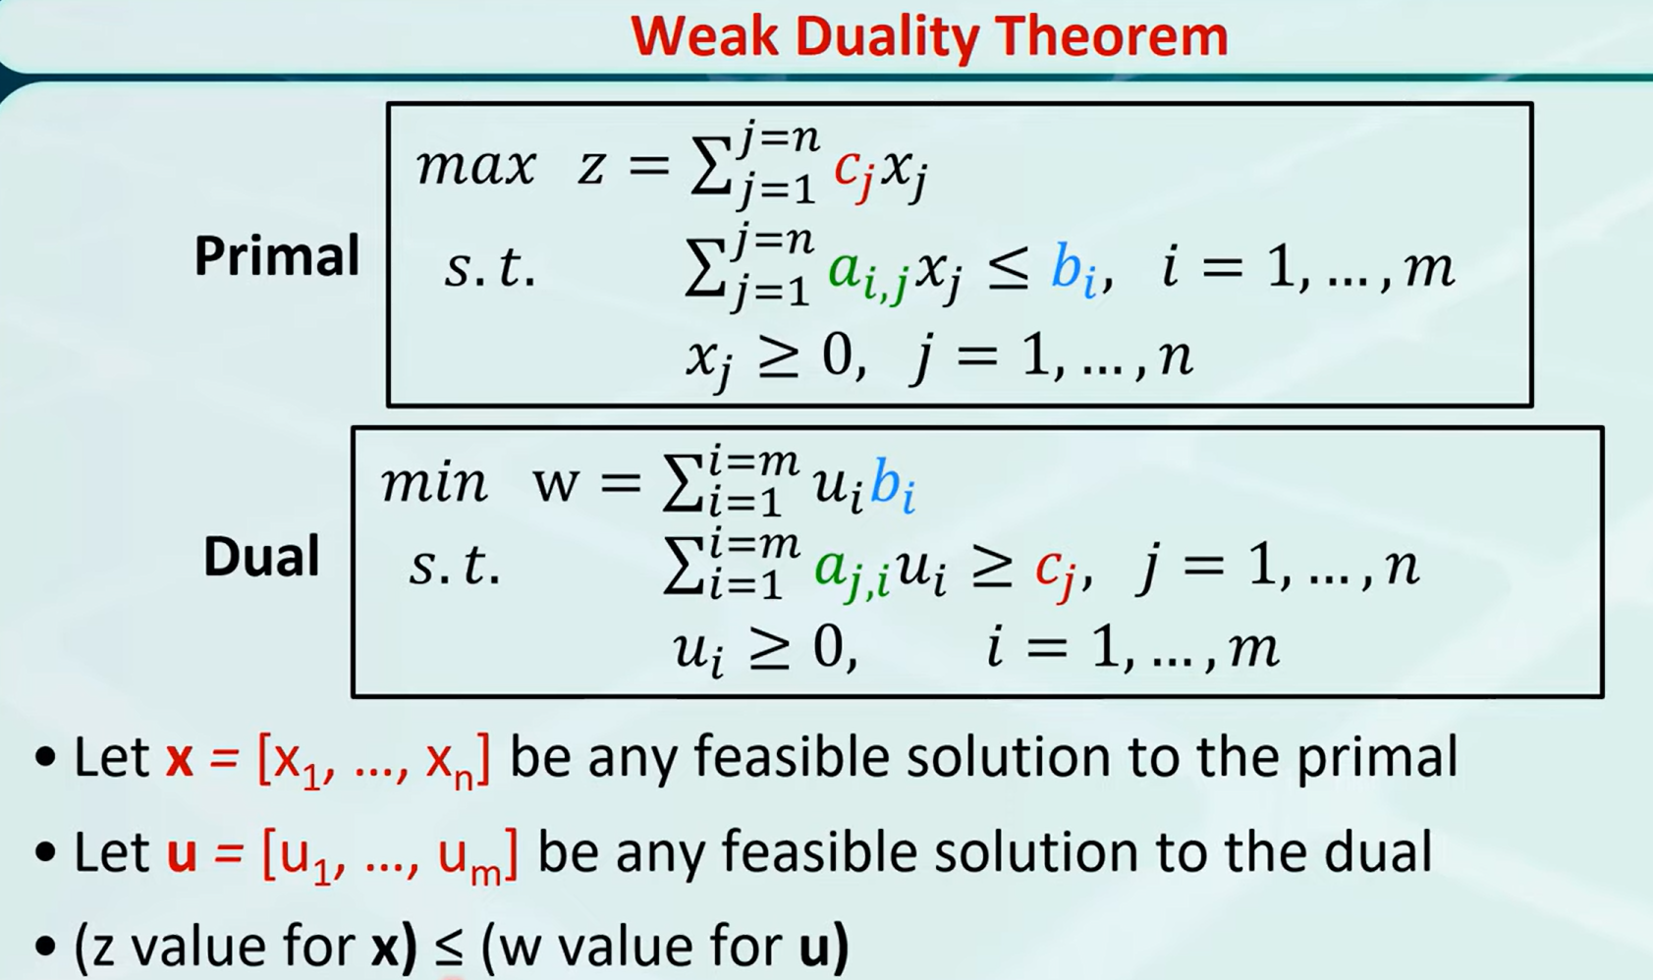

Slide 18
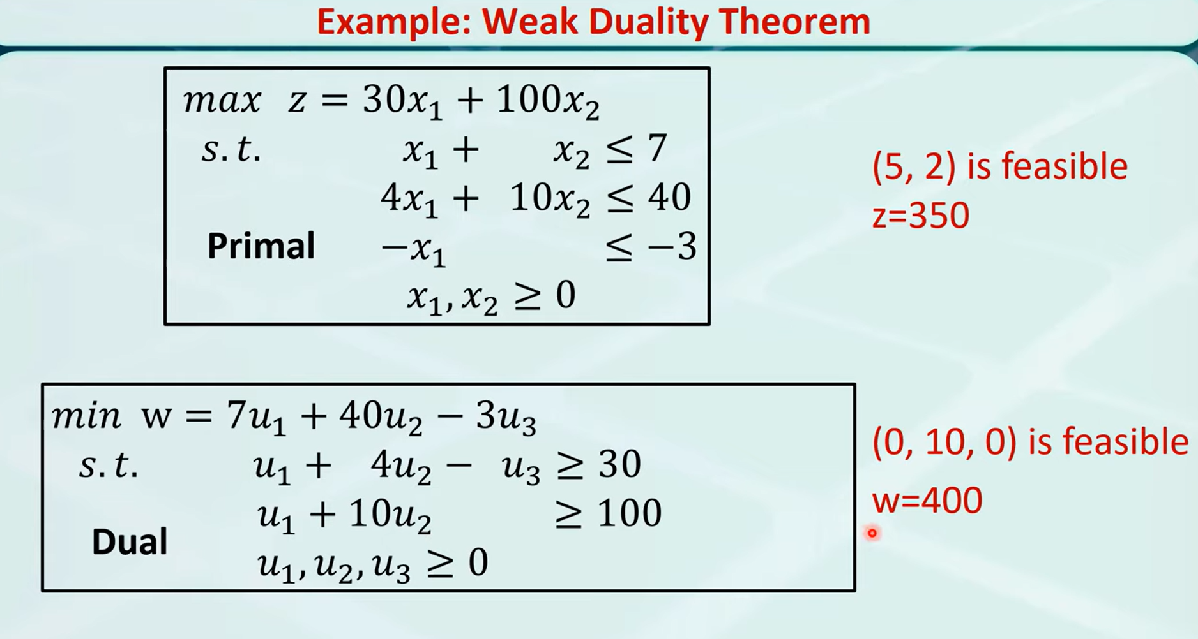

Slide 19
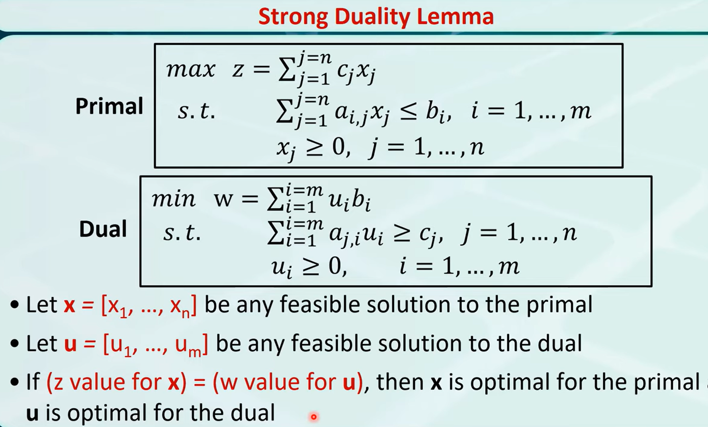

Slide 20
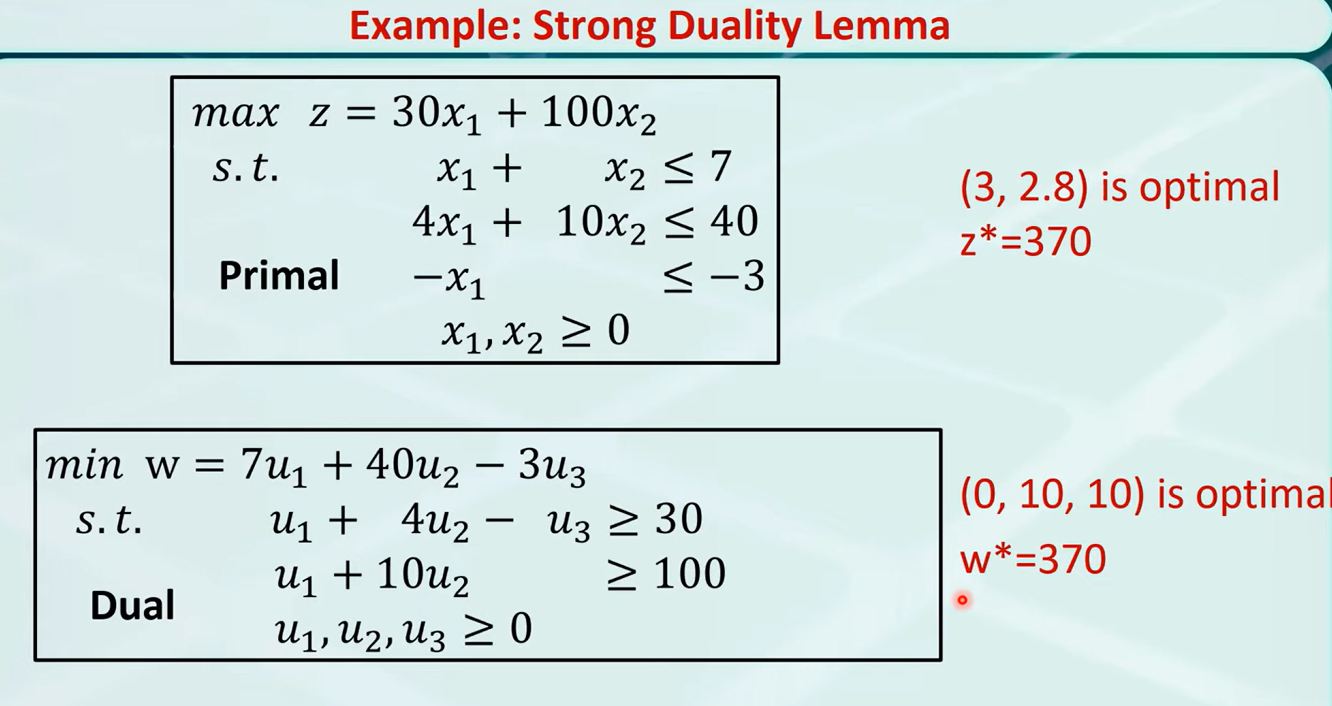

Slide 21
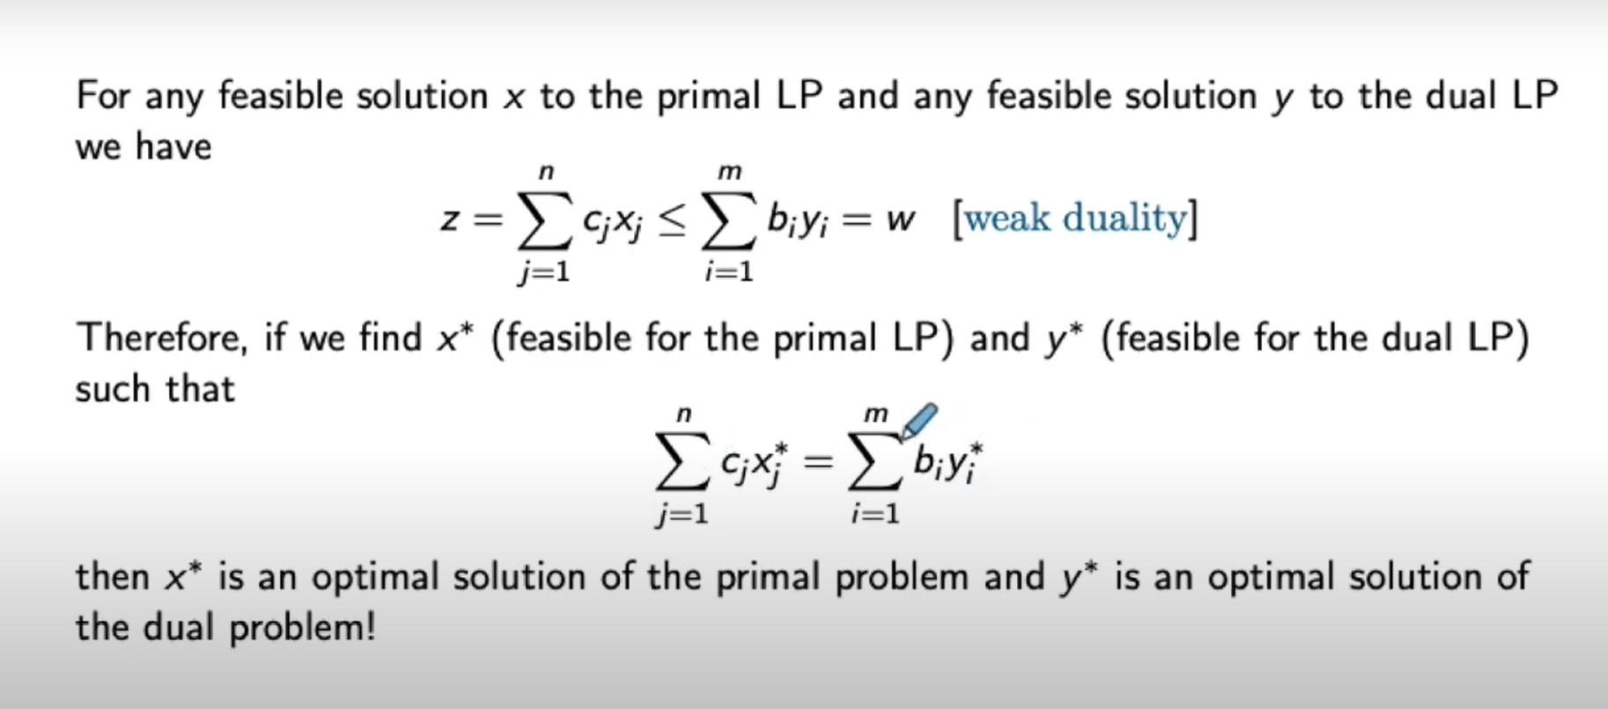
Weak and Strong Duality

Slide 22
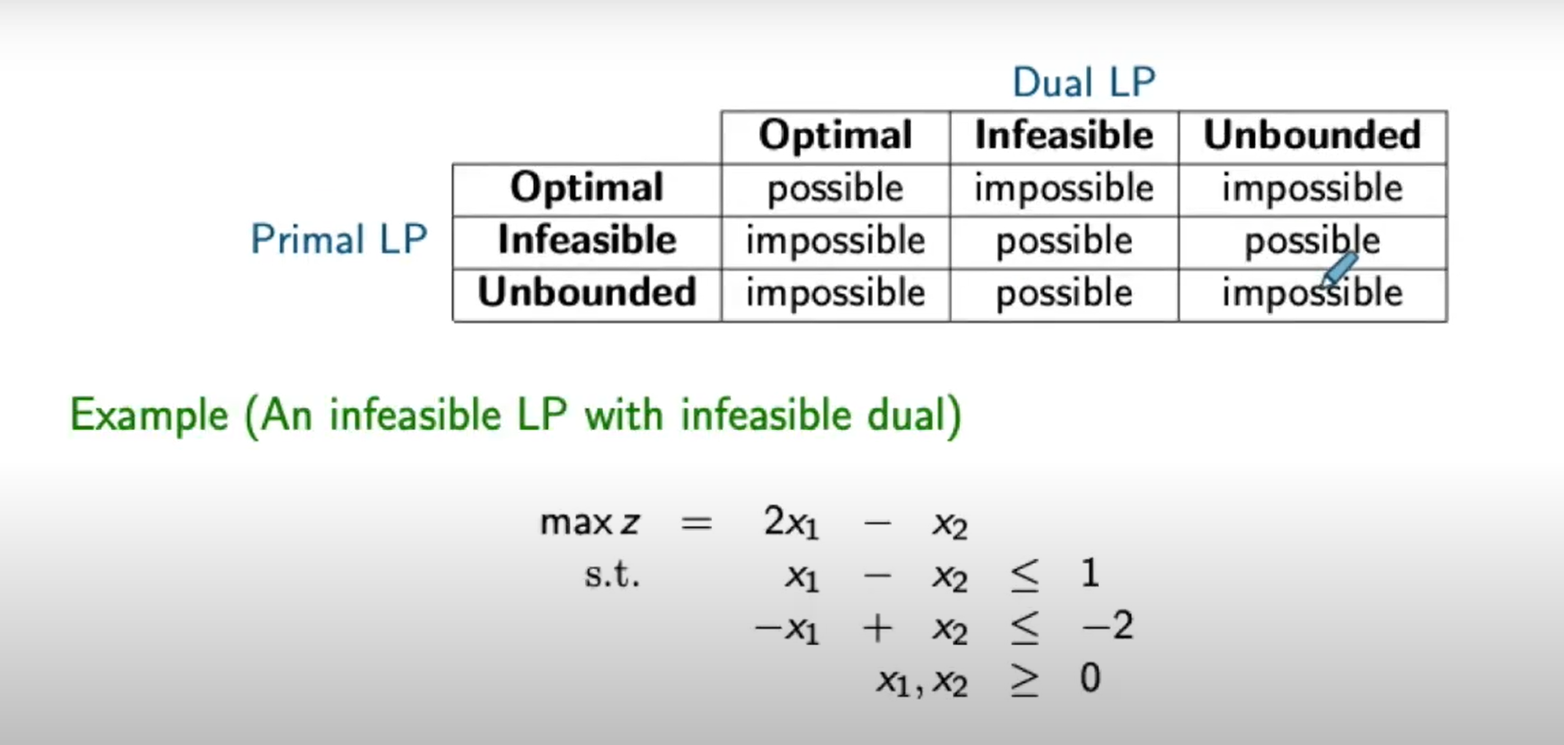
Relation Between Primal and Dual LP Types

Slide 23
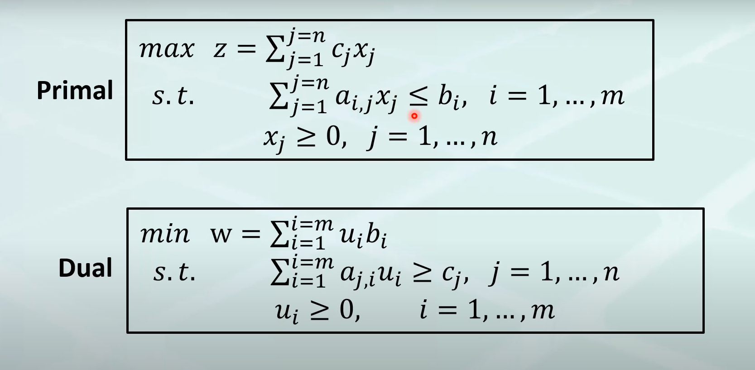
Canonical Form Primal and Dual

Slide 24
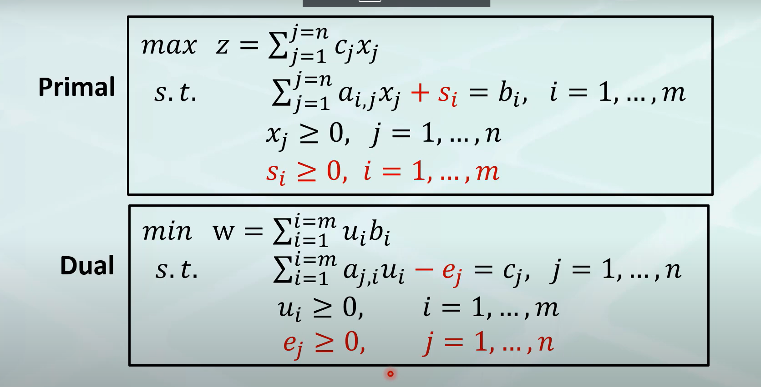
Standard Form Primal and Dual

Slide 25
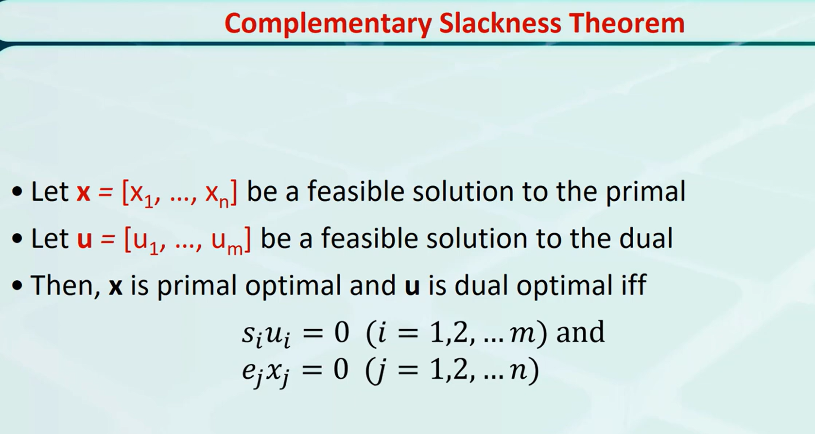

Slide 26
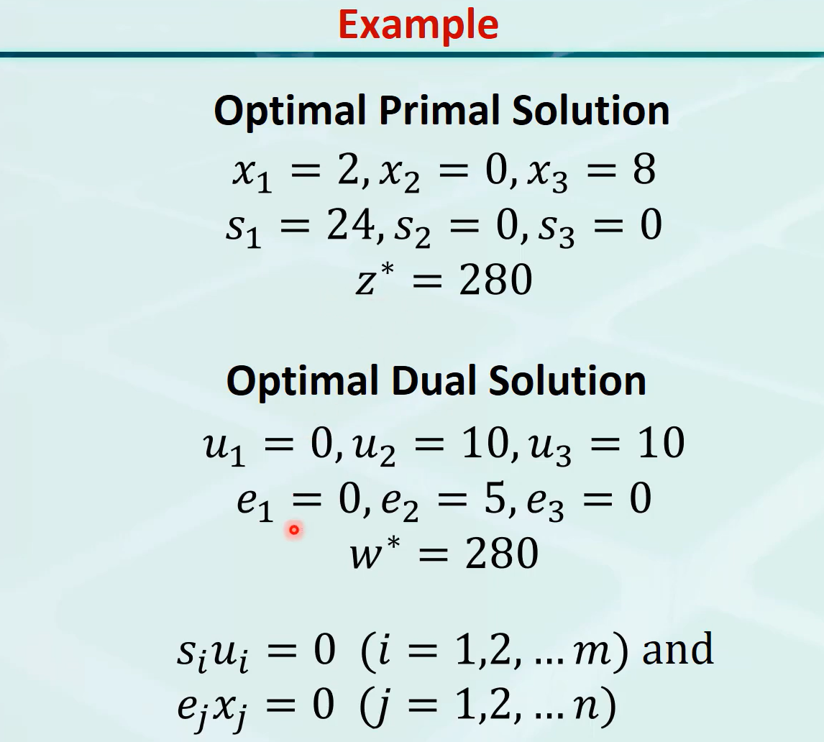

Slide 27
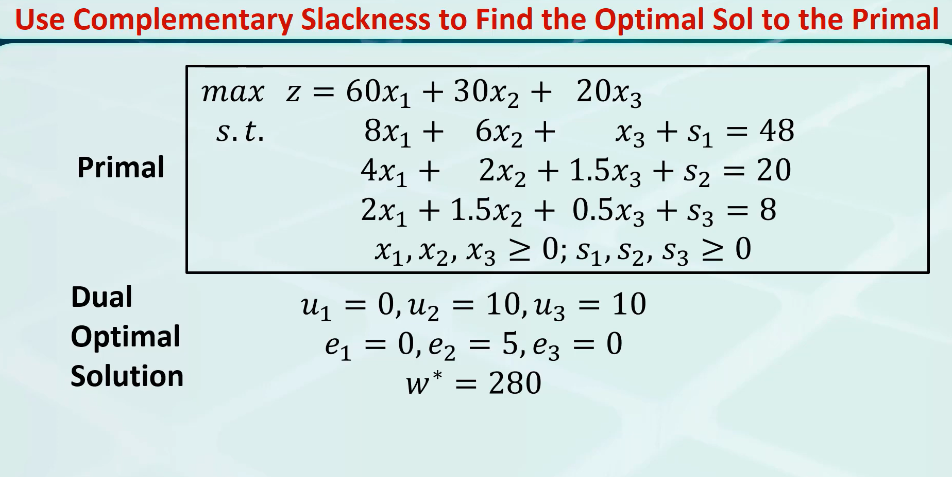

Slide 28
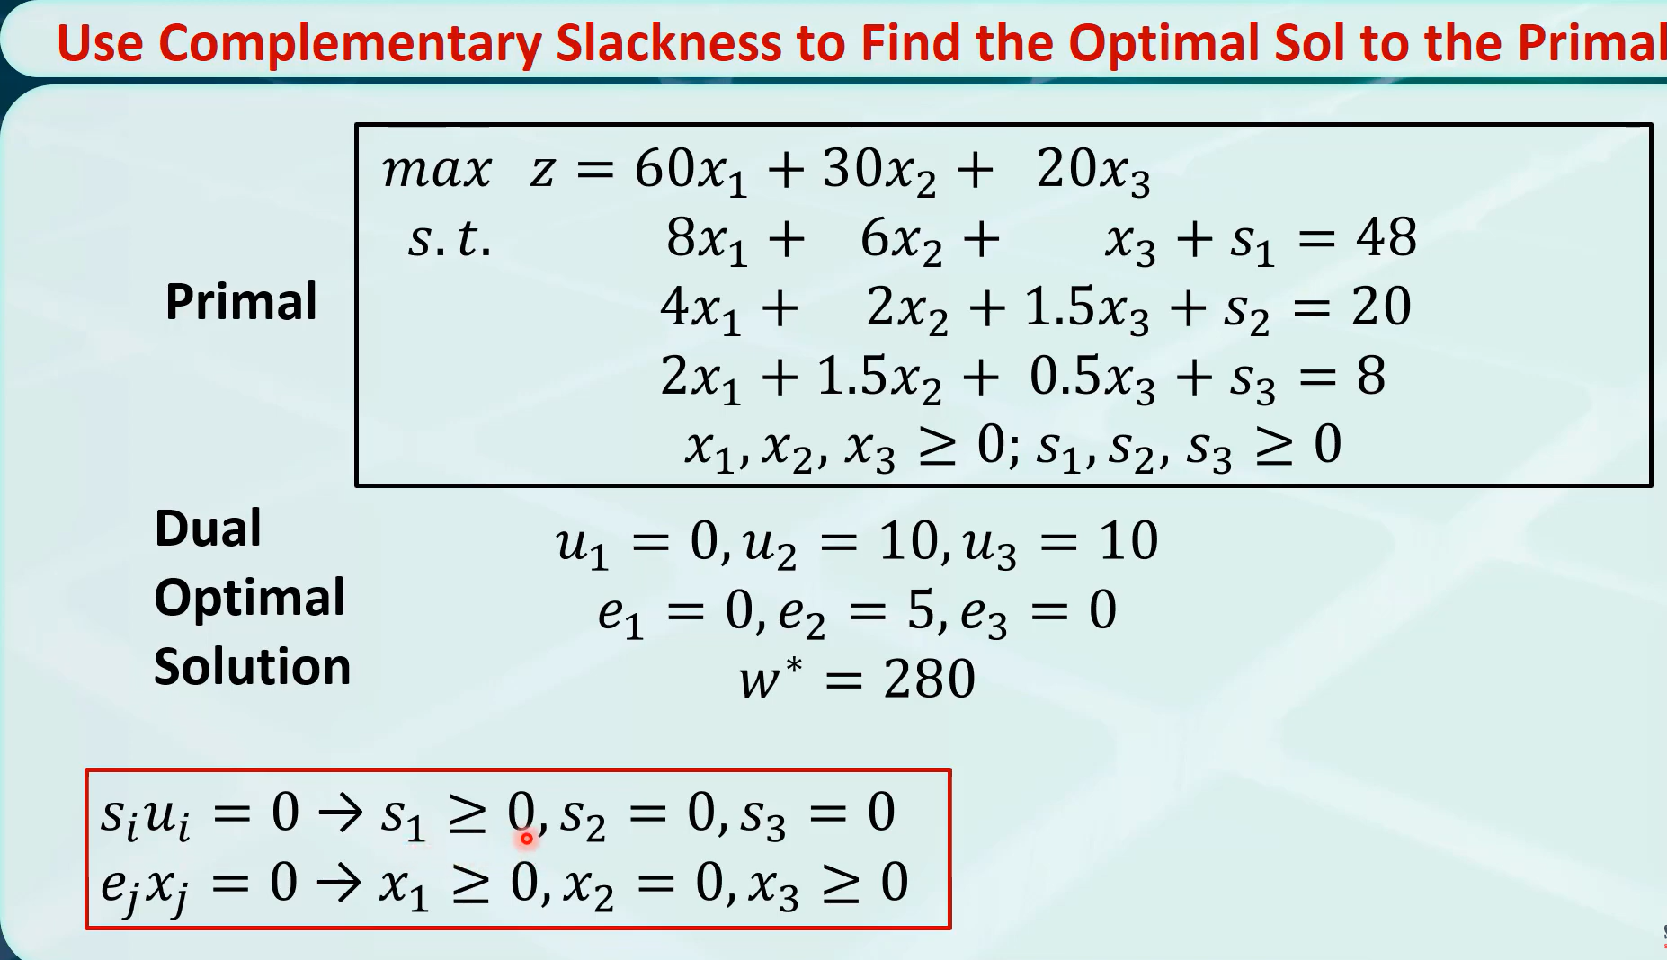

Slide 29
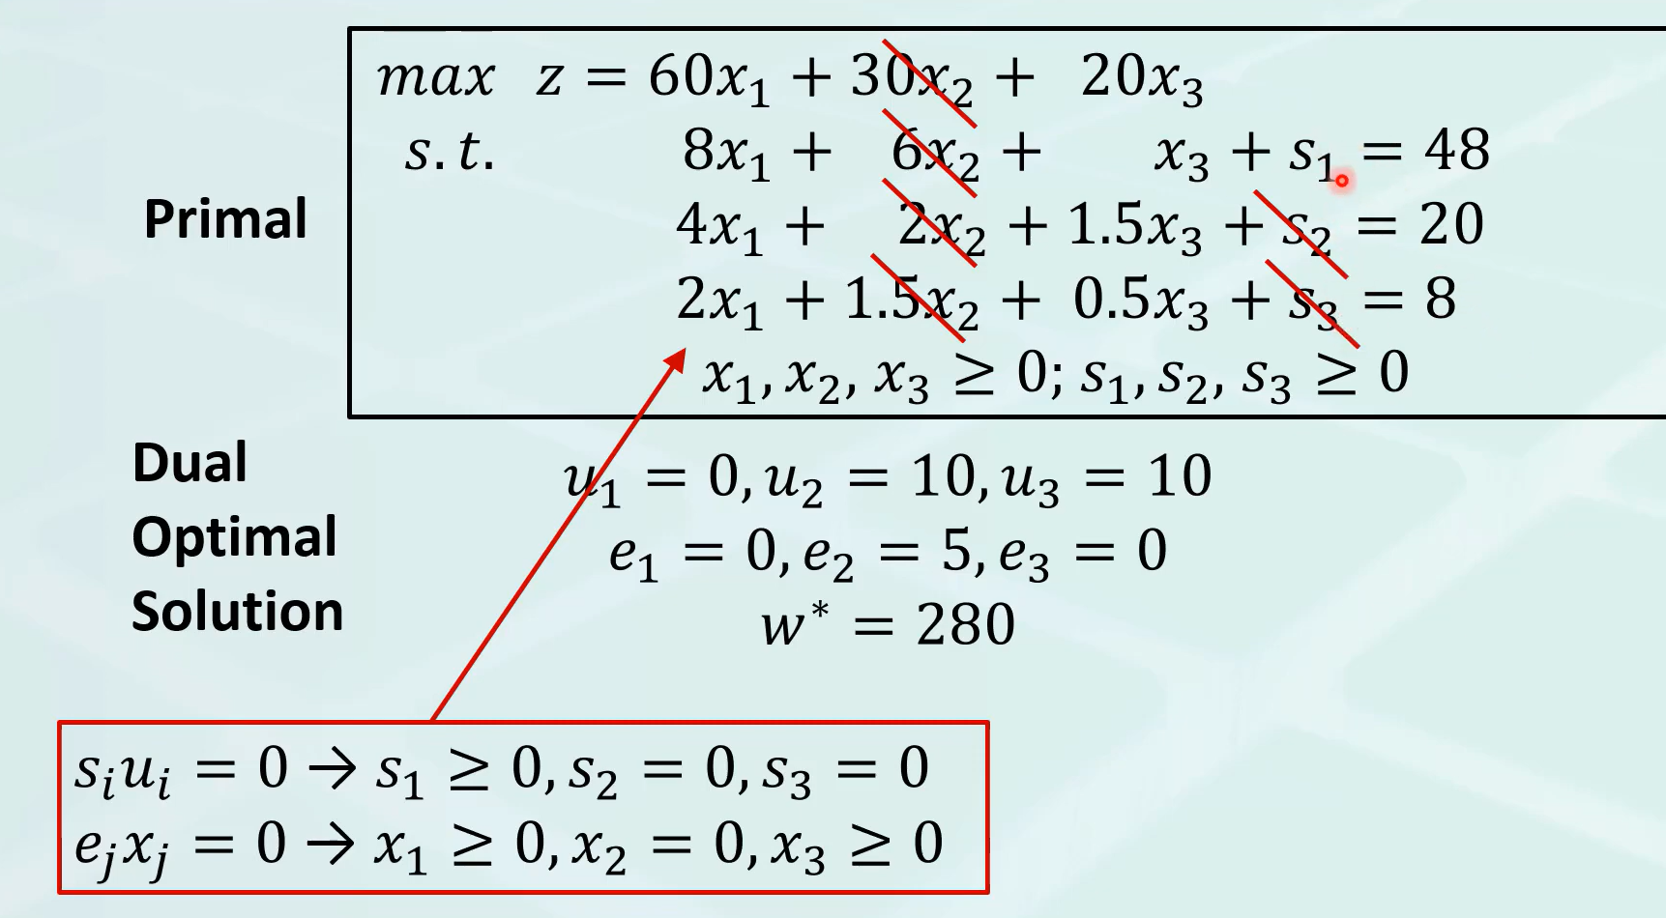

Slide 30
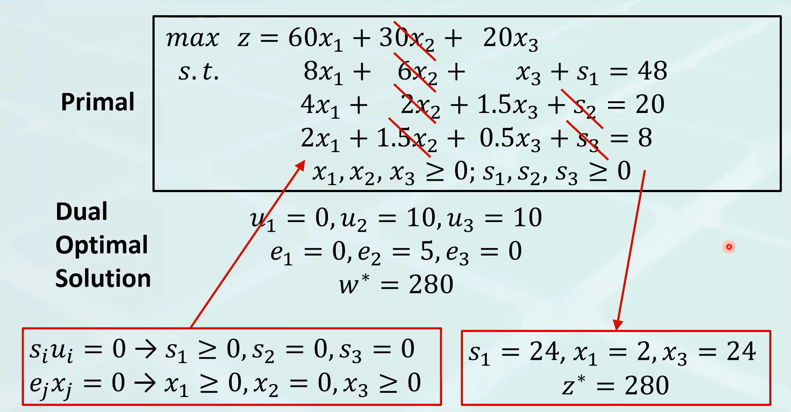

Slide 31
Reverse is also true
We can take the primal and find the solution to the primal

